Slide 1
Coursework presentation
By marcel javorsky - 40403168

Slide 2
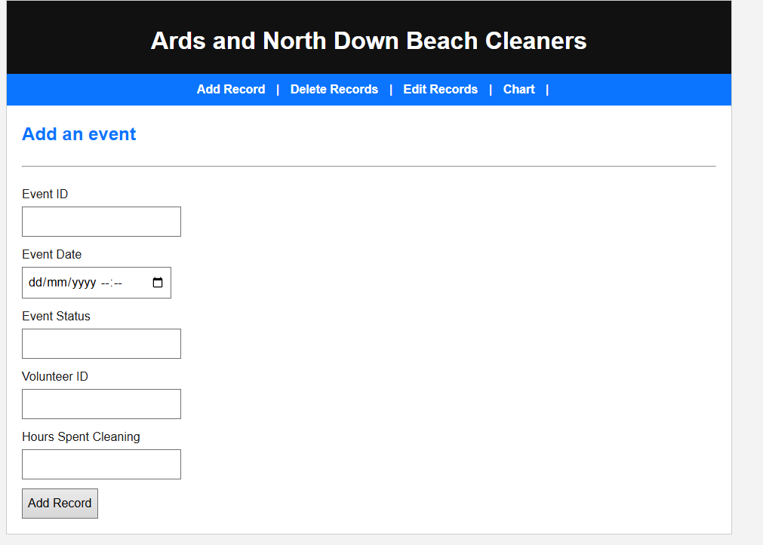
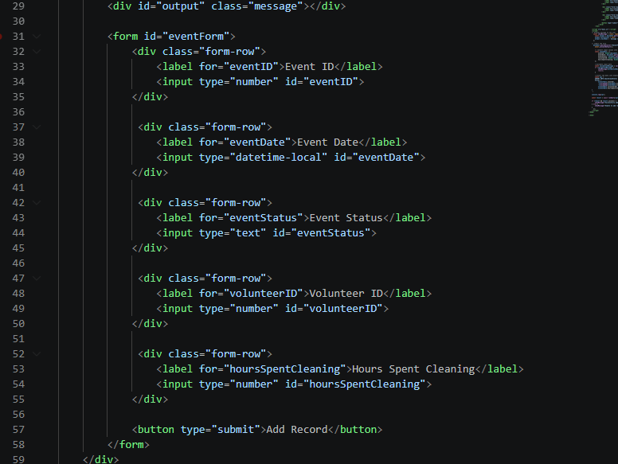
Adding an event
As seen on the left, this is how the add records page appears on the web interface. Here the user can simply enter the details of an event.
Below is the main bulk of the code that displays this information to the user. This code is also used within the other web pages as each page is displayed in a similar manner.

Slide 3
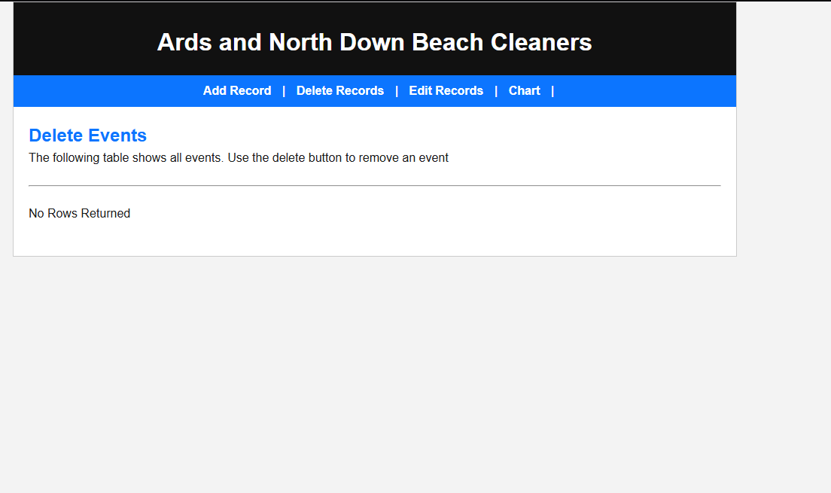
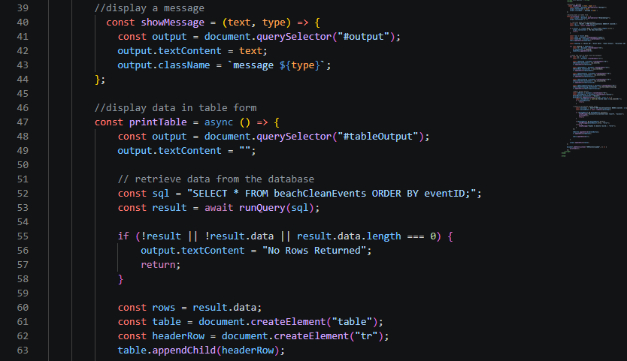
Deleting an event
The delete records page, as seen on the left contains much less information than the add records page, this is because I could not get it work, however it is supposed to display a table of all the events, allowing the user to choose any events to delete.
As seen below, this is the main bulk of code responsible for displaying the table within the delete records page, a lot of testing was done to attempt to fix the issue of the table not appearing, but ultimately, there was no solution found for the issue. The issue could be a number of things, and is likely something to do with calling to the database incorrectly, or the if statement not working as intended.

Slide 4
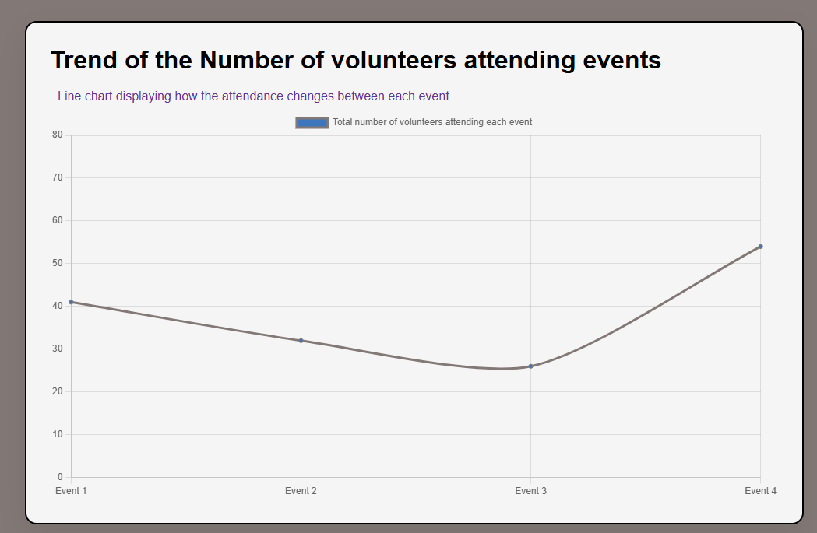
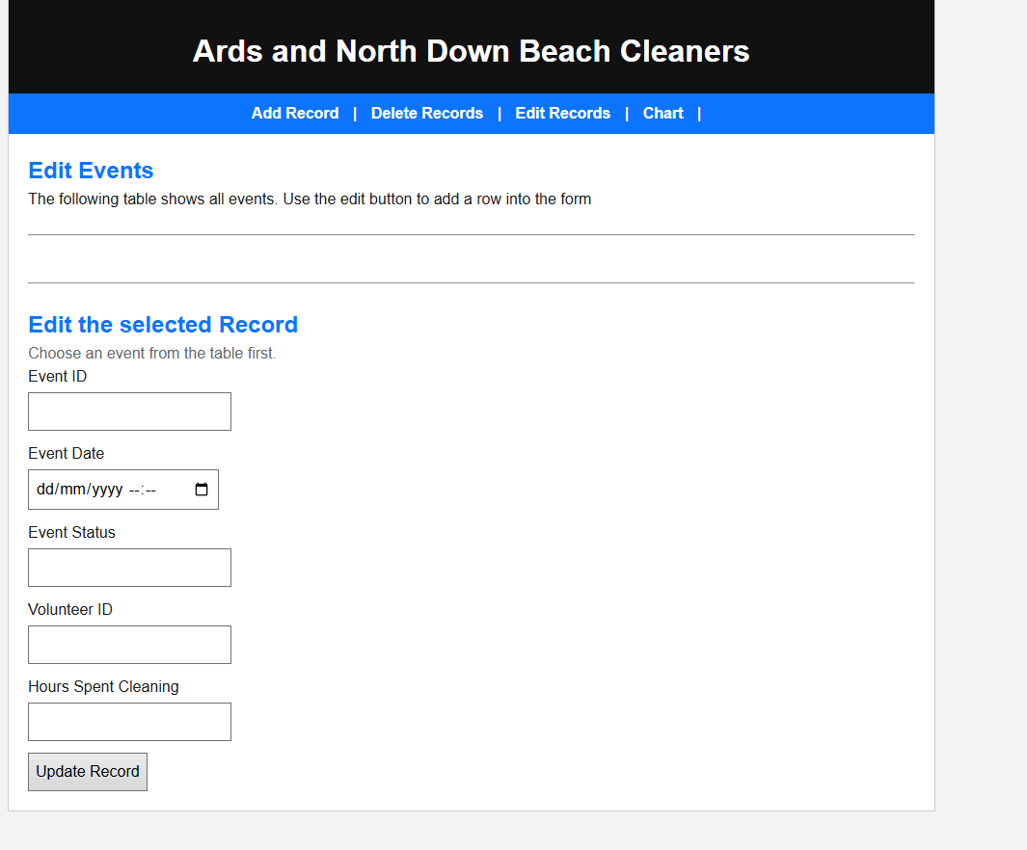
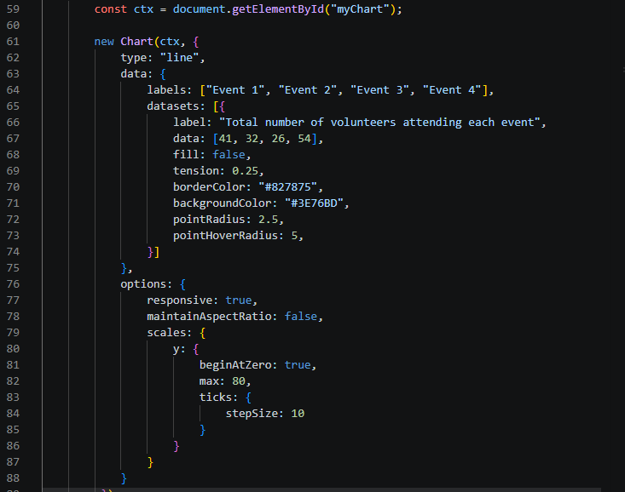
Chart and editing event records
On the other hand, the chart page is a simple one. It simply displays a line graph showing the number volunteers that attend each beach cleaning event. As seen below.
The page that allows a user to edit records is a mixture of the add records page and delete records page, this is because it uses a lot of the same code. Similarly, it allows the user to enter event details to allow them to edit the event, however it also fails to show a table of event records.
The main code that displays this line graph is quite short, however it does not use any data that the user inputs and rather only shows a specific set of data that was set beforehand. The code is pretty self explanatory, and can be seen below:

Slide 5
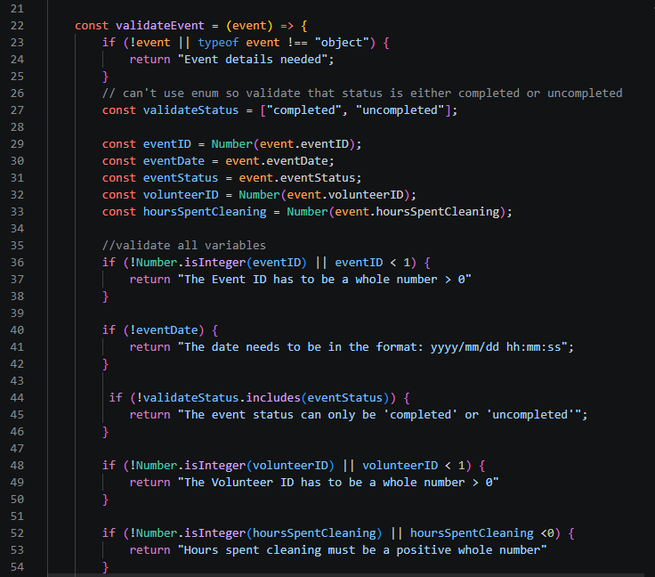
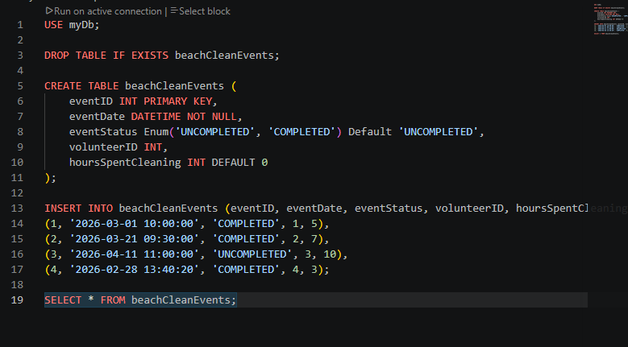
Database and javascript
Each of the pages within the web interface rely on a database, this database could be the cause of some of the information not being displayed within the web pages, however no solution was found.
The database below simply creates a table to define the variables that are used within the project, and some information is inserted into the table so that there is some starting information for the events.
The below code is a part of the code within my javascript file, and is used to validate all the event information within each web page. It appears to function as intended as tested within the add events web page, however it could not be tested on the other web pages due to them not functioning as intended.

